Slide 1
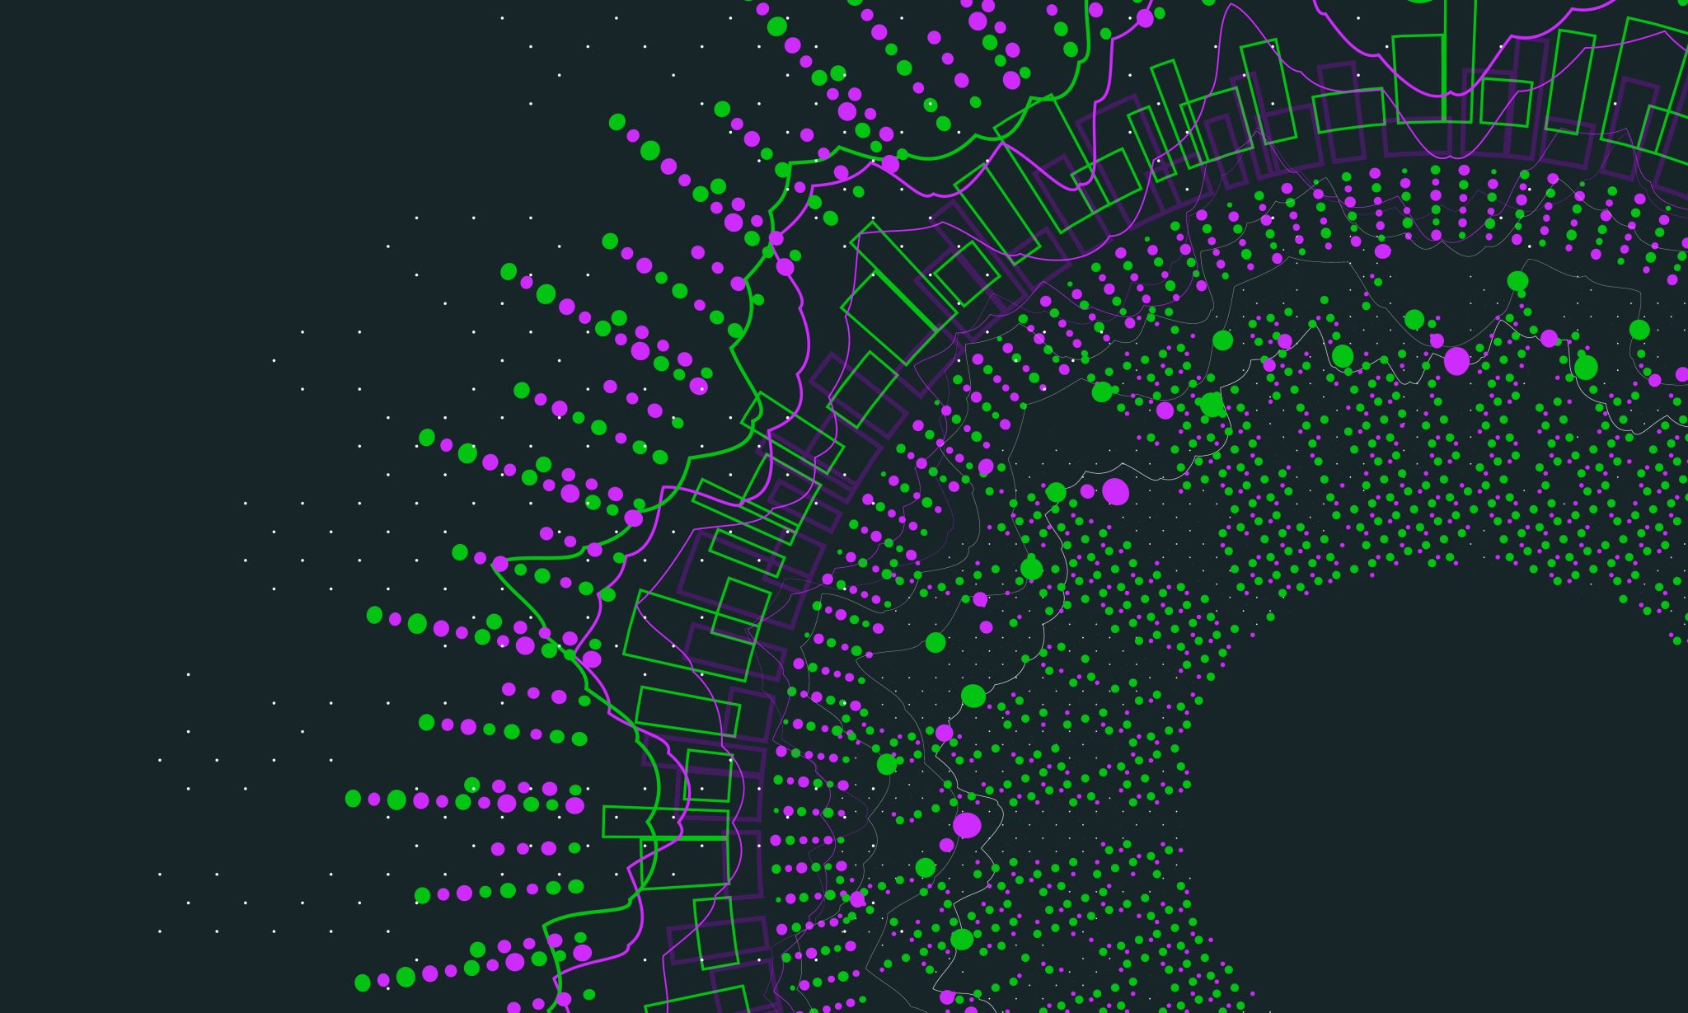
CYBER KILL CHAIN
Gowri Parvathy Devi

Slide 2
What is the Cyber Kill Chain?
The cyber kill chain is an adaptation of the military’s kill chain, which is a step-by-step approach that identifies and stops enemy activity.
The cyber kill chain outlines the various stages of several common cyberattacks and, by extension, the points at which the information security team can prevent, detect or intercept attackers.
The cyber kill chain is intended to defend against sophisticated cyberattacks, also known as advanced persistent threats (APTs)

Slide 3
Phases of the Cyber Kill Chain Process Phase 1: Reconnaissance
During the Reconnaissance phase, a malicious actor identifies a target and explores vulnerabilities and weaknesses that can be exploited within the network
As part of this process, the attacker may harvest login credentials or gather other information, such as email addresses, user IDs, physical locations, software applications and operating system details, all of which may be useful in phishing or spoofing attacks

Slide 4
Phase 2: Weaponization
During the Weaponization phase, the attacker creates an attack vector, such as remote access malware, ransomware, virus or worm that can exploit a known vulnerability.
During this phase, the attacker may also set up back doors so that they can continue to access to the system if their original point of entry is identified and closed by network administrators

Slide 5
Phase 3: Delivery
In the Delivery step, the intruder launches the attack.
The specific steps taken will depend on the type of attack they intend to carry out.
The attacker may send email attachments or a malicious link to spur user activity to advance the plan. This activity may be combined with social engineering techniques to increase the effectiveness of the campaign.

Slide 6
Phase 4: Exploitation
In the Exploitation phase, the malicious code is executed within the victim’s system.
Immediately following the Exploitation phase, the malware or other attack vector will be installed on the victim’s system. This is a turning point in the attack lifecycle, as the threat actor has entered the system and can now assume control.
Phase 5: Installation

Slide 7
Phase 6: Command and Control
In Command & Control, the attacker can use the malware to assume remote control of a device or identity within the target network.
The attacker may also work to move laterally throughout the network, expanding their access and establishing more points of entry for the future.

Slide 8
Phase 7: Actions on Objective
Expanded Kill Chain: The traditional cyber kill chain now includes an eighth step: Monetization. Here, attackers seek financial gain by demanding ransoms or selling stolen data.
Early Intervention: Detecting threats early in the cyber attack lifecycle is crucial. Attacks reaching the Command-and-Control phase require extensive remediation, highlighting the importance of proactive threat detection to minimize risks and costs.

Slide 9
Role of the Cyber Kill Chain in Cybersecurity The Cyber Kill Chain plays an important role in helping organizations define their cybersecurity strategy
Detect attackers within each stage of the threat lifecycle with threat intelligence techniques
Prevent access from unauthorized users
Stop sensitive data from being shared, saved, altered, exfiltrated or encrypted by unauthorized users
Respond to attacks in real-time
Stop lateral movement of an attacker within the network

Slide 10
THANK YOU

